Slide 2
From Sprints to Sentience
How AI is Supercharging Agile Workflows
Notes:
What if your Agile team had game changing tools for crushing repetitive tasks and boosting collaboration? What I want to show you today is how AI is transforming workflows and giving you the tools to unlock your team’s full potential.
But I’m not just going to talk about it – I’m going to show you some current reality using a new tool I’ve been building called Sierra Agility.

Slide 3
About Me
40 years of IT experience
33 years in leadership and management
CST since 2005
1300+ classes
24000+ students
Instructor/Coach/Consultant
Supported 30+ Agile Transformations

Slide 4
The BIG Questions
How can AI support Scrum teams?
How can AI support product development?
Is AI coming for my job?

Slide 5
The Role of AI in Agility
Making a Difference
Advantages and Futures

Slide 6
The Role of AI in Agility

Slide 7
The Fall of Waterfall
Market
User
Technology

Slide 8
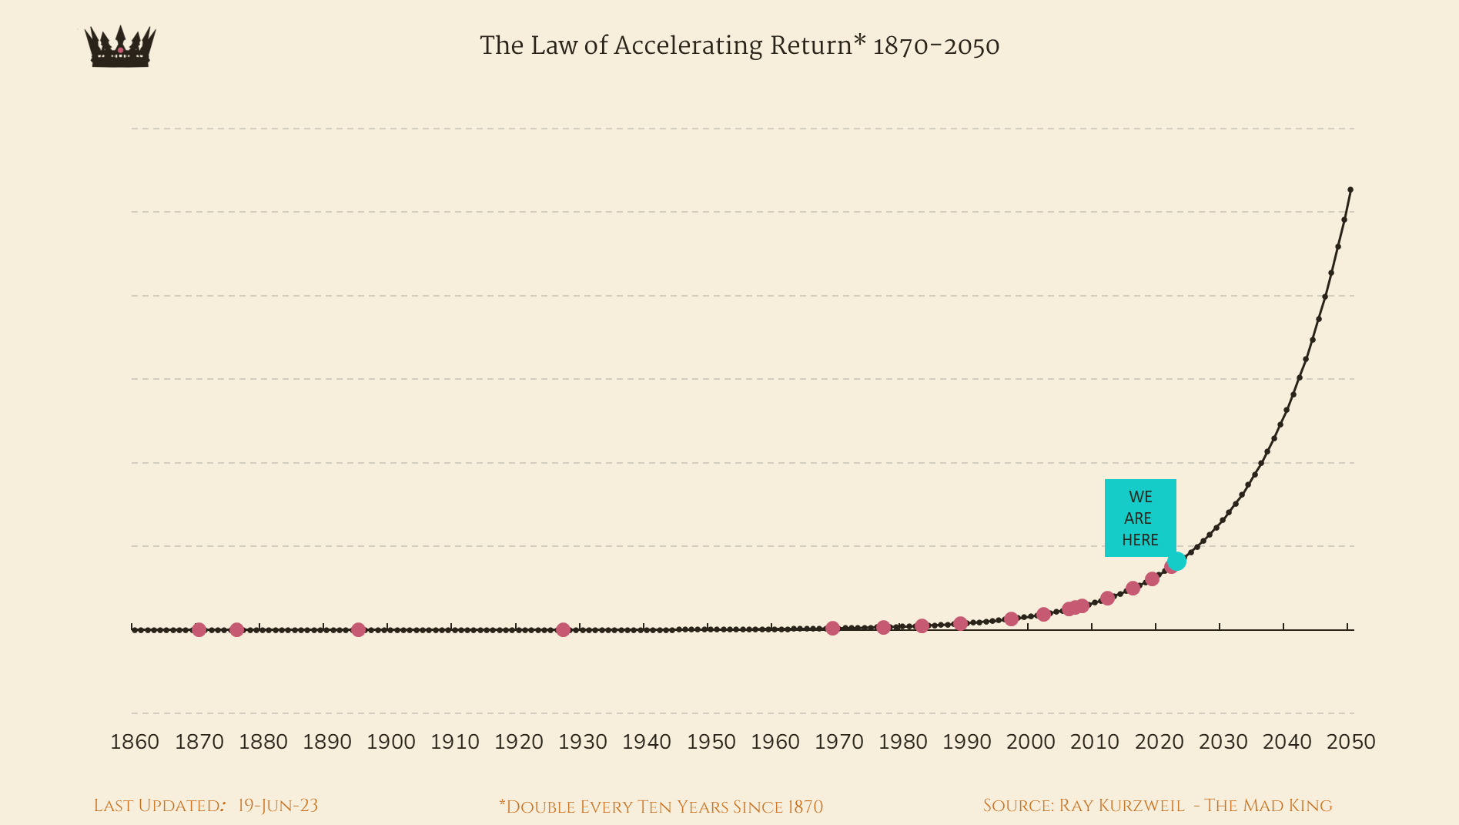
The Law of Accelerating Returns
Oculus Rift
(2016)
Amazon Echo (2014)
Gen-AI (2020)
Siri
(2011)
ChatGPT (2011)
eCommerce (2010)
iPhone (2007)
“We will see as much technological growth in the 21st century as we saw in 20 years in the 20th century.”
- Raymond Kurzweil
Cloud Computing (2006)
Social Media (2002)
Internet (1995)
Telephone
(1876)
Personal Computers (1981-1985)
Space Travel
(1957)
Telegraph (1876)
Automobile (1886)
Television
(1920)
Computers
(1941)
Transistors
(1947)

Slide 9
Sentient Sprinting
“By augmenting the workflow of the sprint with AI, we re-instill the wonder and innovation inherent in creating valuable outcomes for the world.”

Slide 10
AIs Replaces Developers? NO
“Hallucination”
Limited imagination

Slide 11
Making a Difference

Slide 12
The Challenges
How to be an effective Scrum Master
How to be an effective Product Owner
Ineffective backlog item slicing
No product goals
Unclear product strategies
Poorly written sprint goals
Time intensive acceptance criteria writing
Over-planning the Sprint
Unidentified dependencies between backlog items
Notes:
While these are difficult challenges, the opportunities they present for artificial intelligence to elevate Scrum team members and improve how individuals interact and how they get work done.

Slide 13
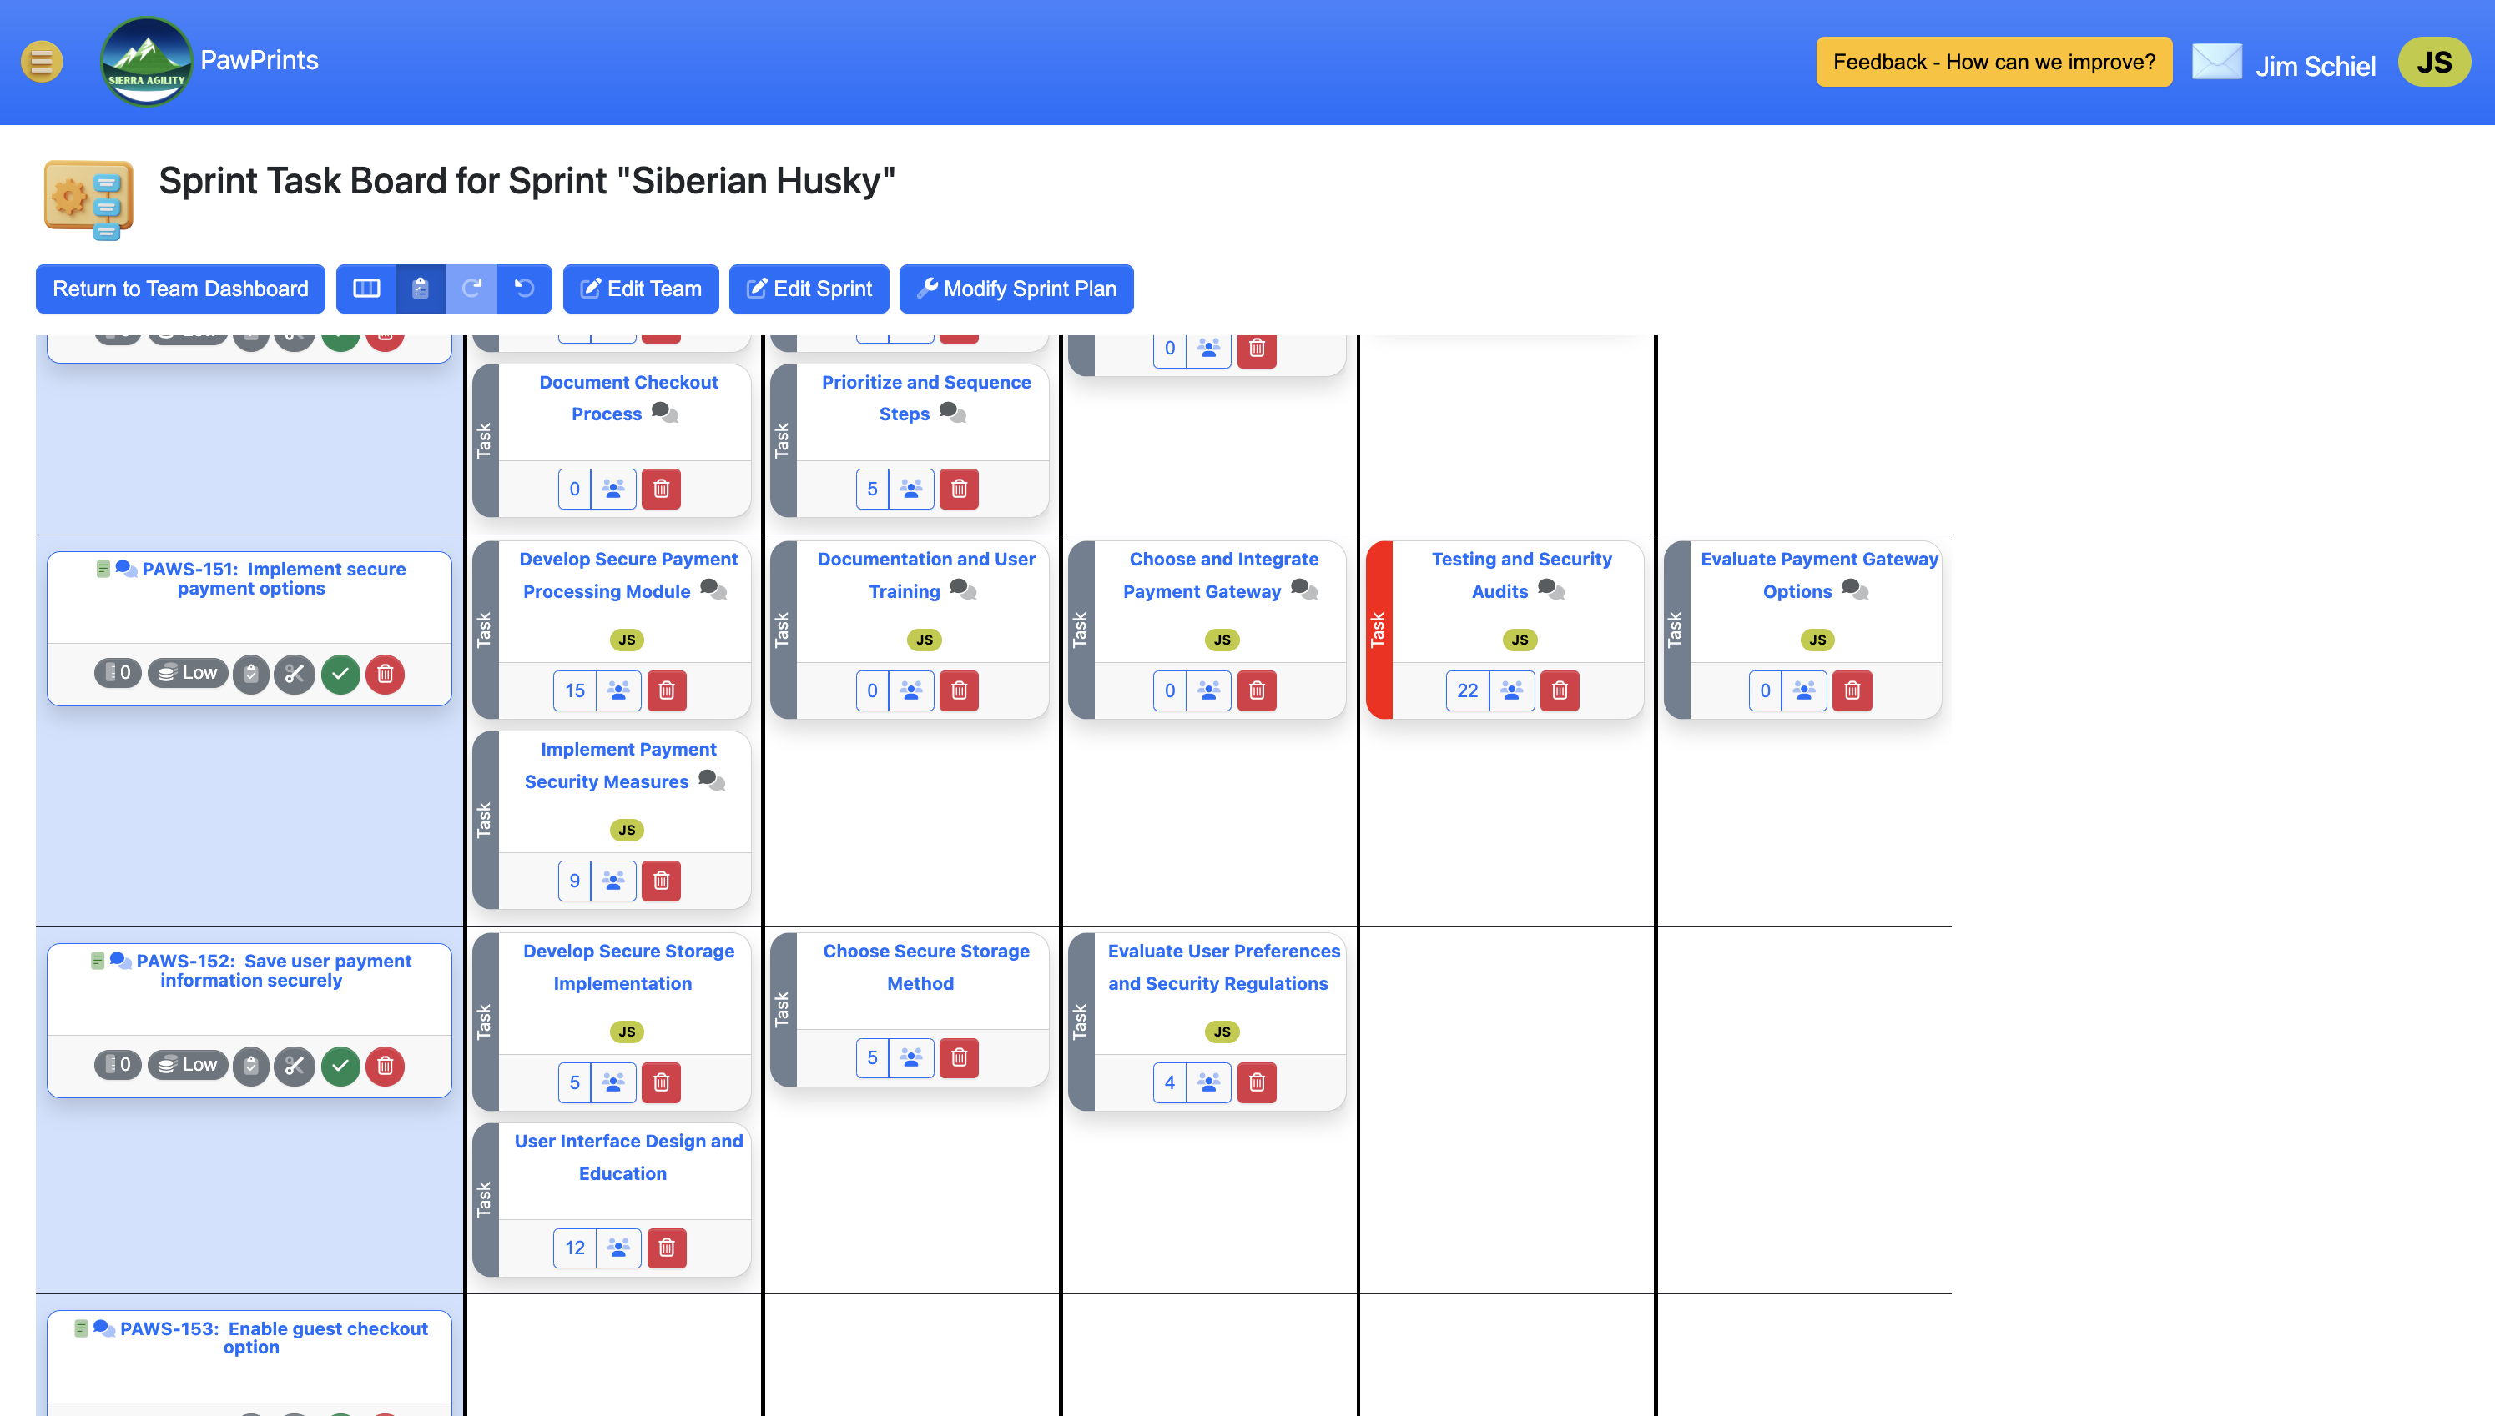
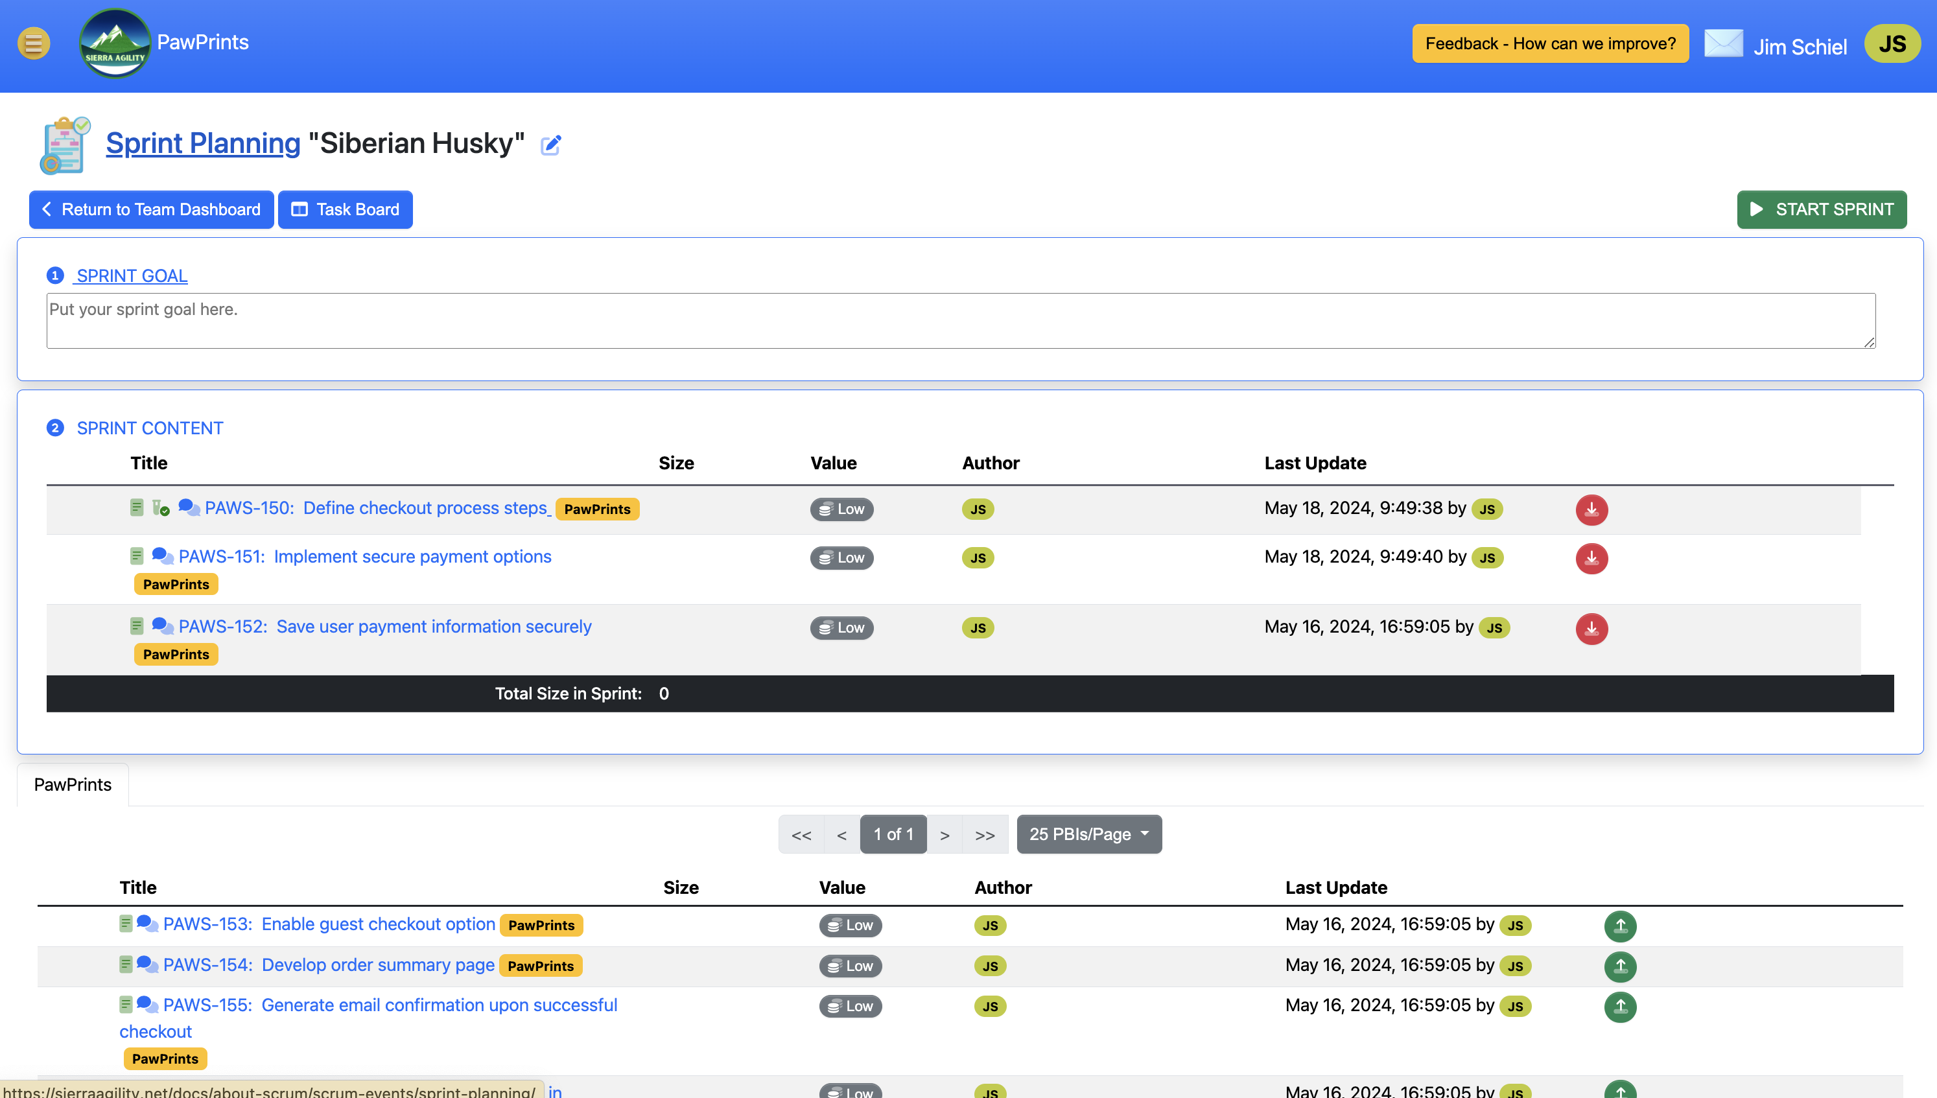
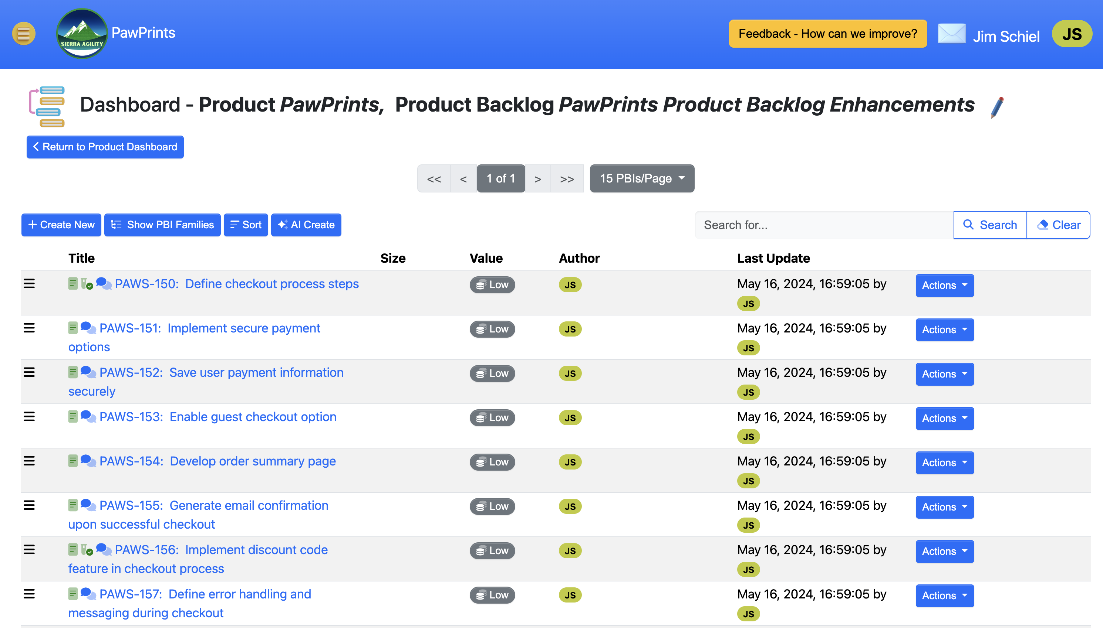
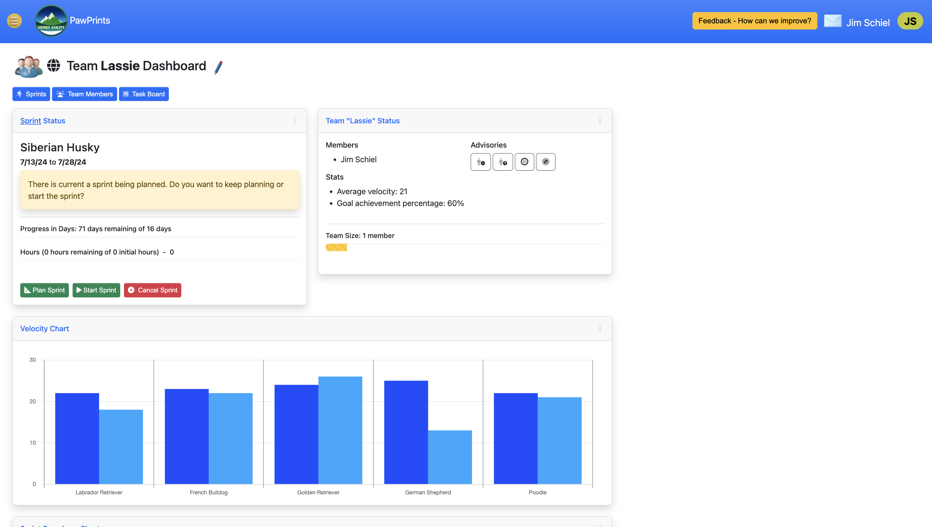
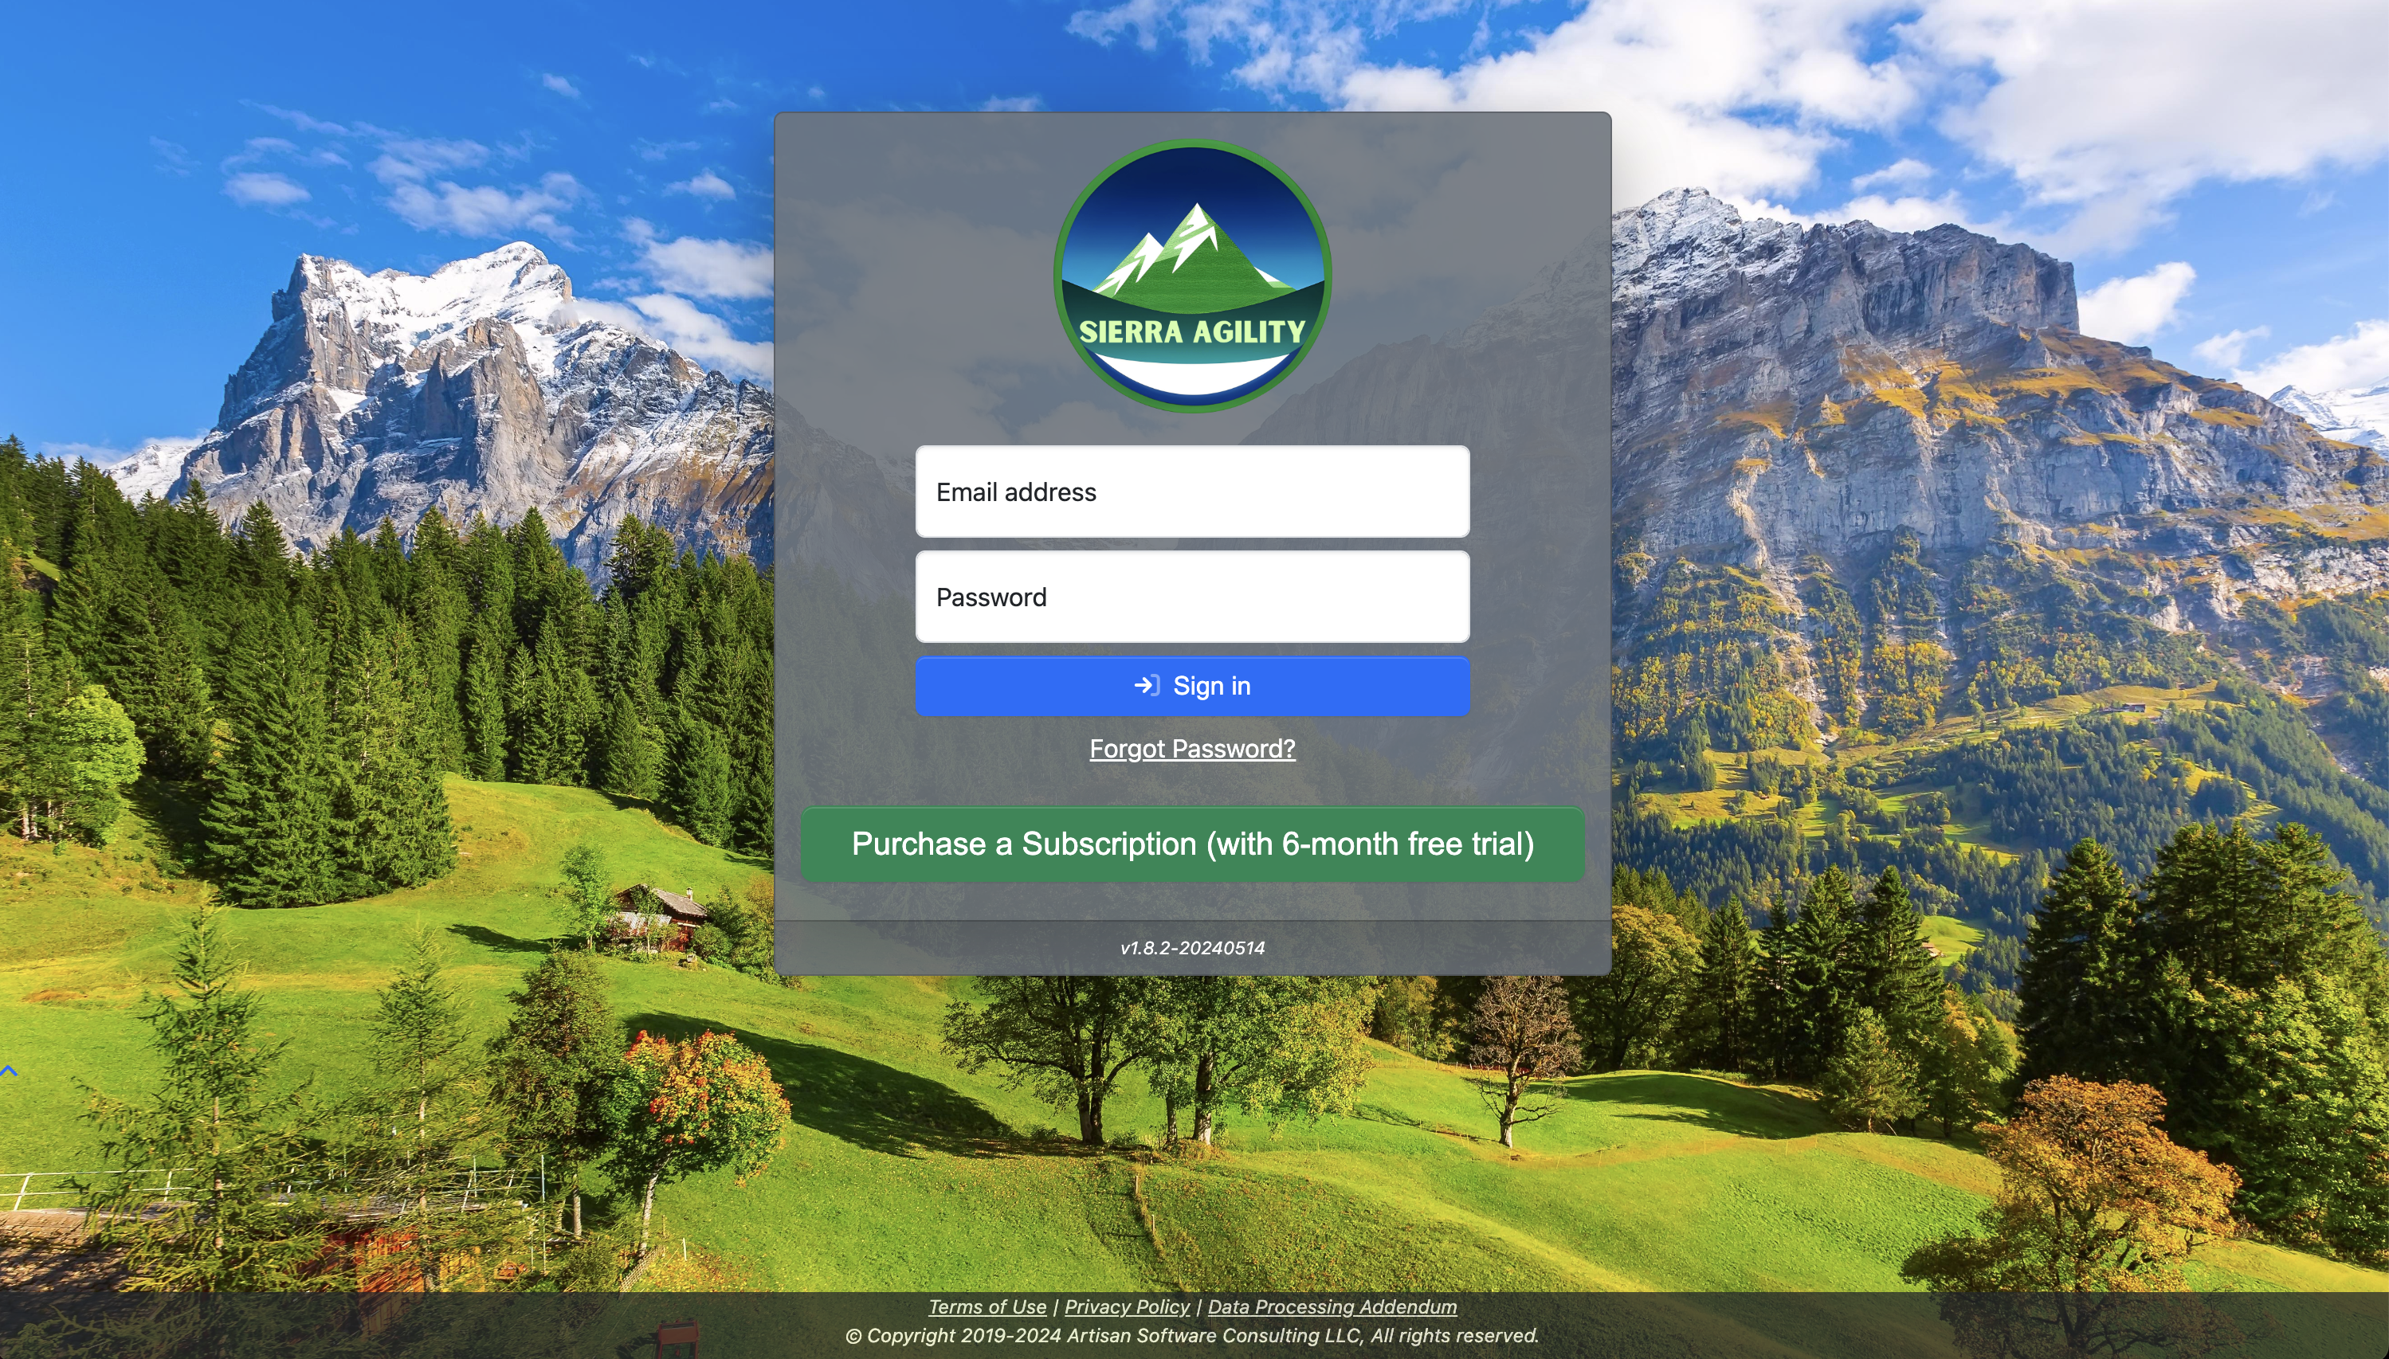
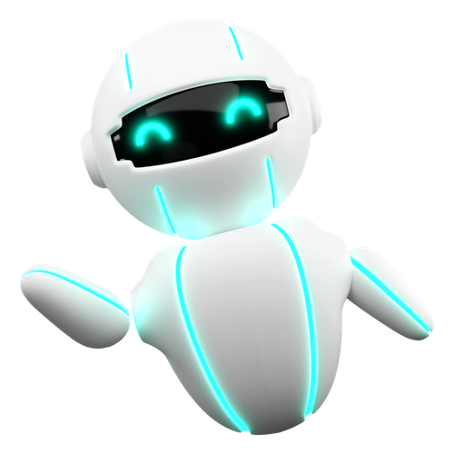
Introducing Sierra Agility
For Scrum teams
AI enabled (Spark)
Currently in beta
“Sentient” workflow
Notes:
Spark’s job is to take what we already do (maintaining product backlogs, managing sprints, tracking work) and create a sentient workflow – that is, a workflow that, instead of relying on humans for everything, starts helping get the work done for us.

Slide 14
Something Simple to Start…
Sprint names
Sprint length
Recommend capacity

Slide 16
Daily Recommendations
Accountability specific
Expertise driven
Data driven
Goal achievement
Task burndown
Product backlog condition

Slide 17
Notes:
Looks at team goals and achievements
Does a regression analysis on the task burndown
Looks at the condition of the product backlog (value, sizing, order,…)
AIs can be taught – we’ve put years of experience into our AI assistants and we’re constantly adding more

Slide 18
The Game Changers

Slide 19
Game Changer #1 Product Goals
Poorly written
Not written

Slide 20
Confusion

Slide 21
Frustration!
Wasted Time
Defects
Missed Deadlines

Slide 22
Product Analysis
Product Vision
Strategic Goals
Competitor Info
Stakeholder Needs

Slide 24
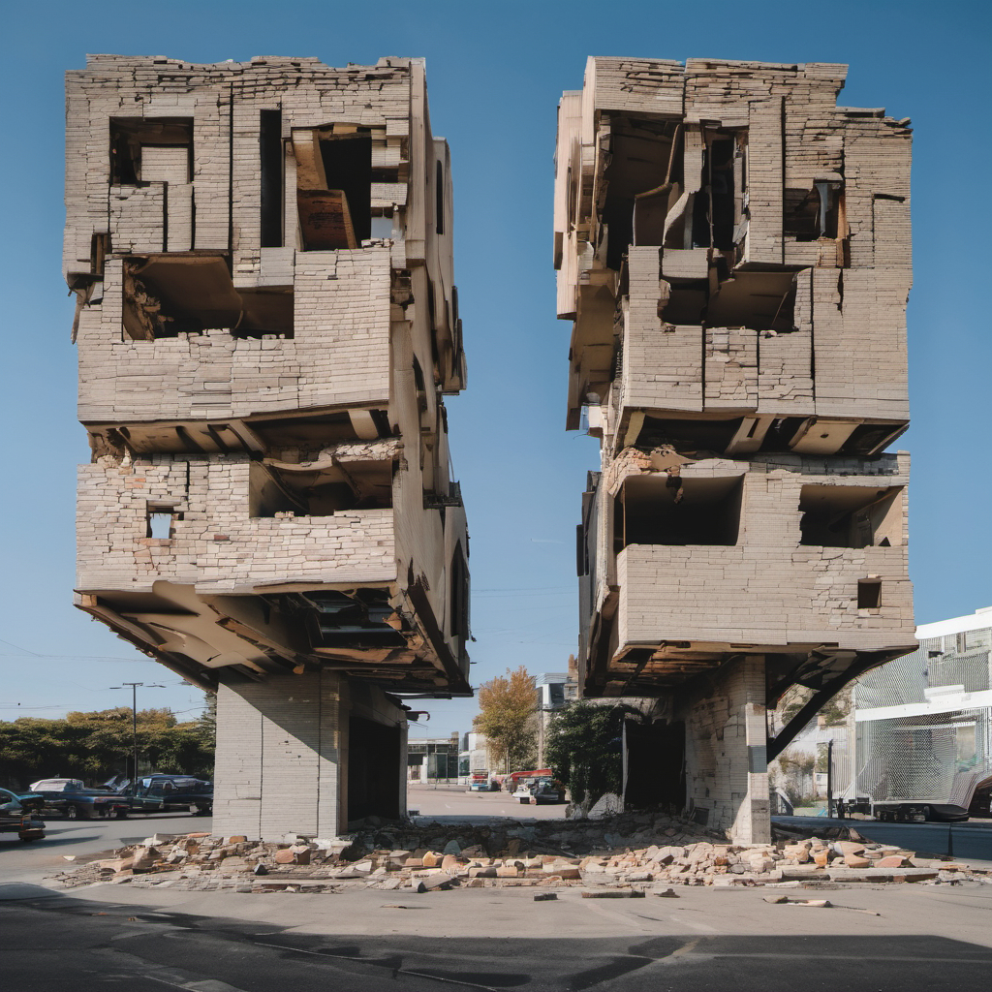
Game Changer #2 Backlog Item Slicing
Need image
Ineffective
Too big
Horizontal
Notes:
Do you know what happens when your teams build poorly sliced backlog items? Backlog items that are too big, sliced horizontally, are solutions instead of needs?

Slide 25
Technical Debt

Slide 27
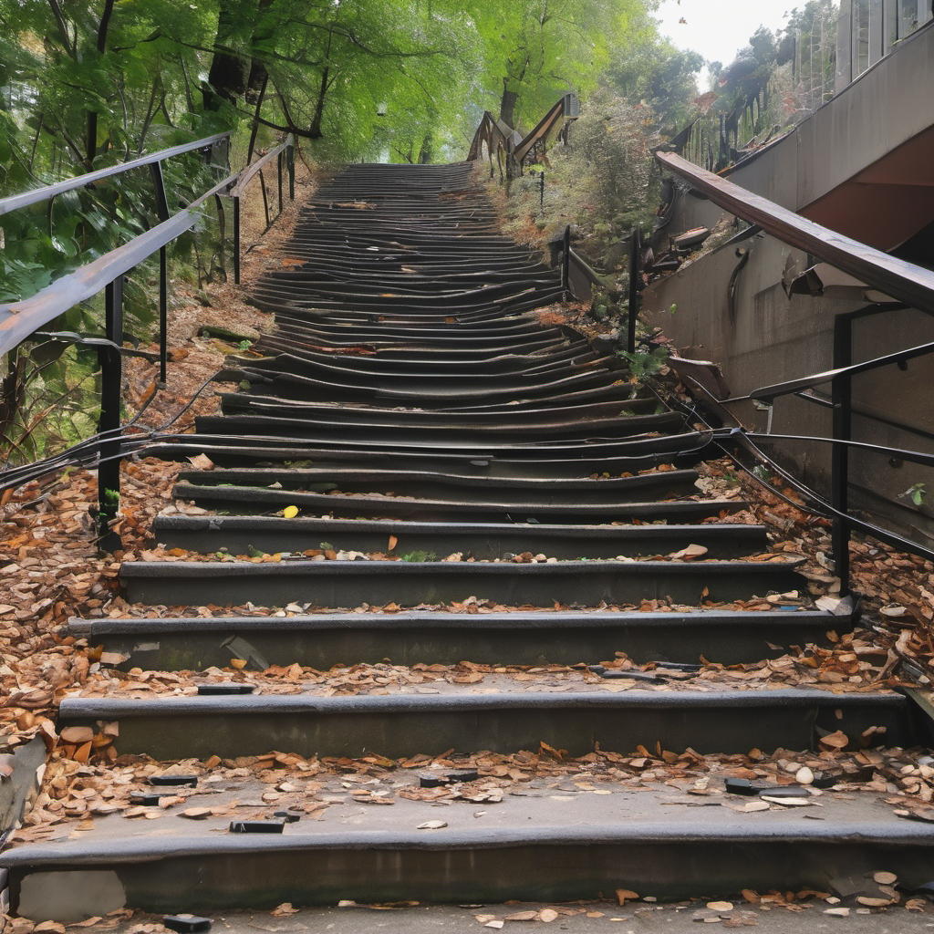
Game Changer #3 Acceptance Criteria
Time consuming
Hard to write

Slide 28
Ineffective Planning

Slide 30
Game Changer #4 Test Cases
Time consuming
Hard to write
Often skipped

Slide 31
More Debt!

Slide 33
Advantages and Futures

Slide 34
The Advantages of AI
Expert Knowledge
Easy to Train
Data Focused

Slide 35
In the (near) future…
Ideas to use in the team’s retrospective to generate action plans.
Solution approaches that can be included in team discussions.
Estimation support.
Automatic dependency identification
Automatic task generation
Tasks that move themselves across the task board.
Abstraction of key discussion points auto-added to the right backlog items.
Alerting team members (other teams, stakeholders) on key events.

Slide 36
What’s Next?
Try it out and see what’s possible!
Learn more about AI
Use ChatGPT/Gemini yourself and with your teams

Slide 37
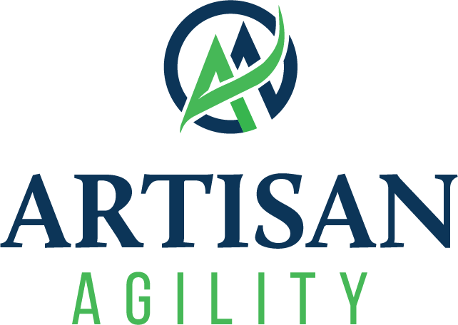
From Sprints to Sentience
How AI is Supercharging Agile Workflows

